Slide 1
Logic Agents and Propositional Logic
CHAPTER 7
Oliver Schulte
Notes:
Todo:
ask Jim about examples of complex rule systems.

Slide 2

Model-based Agents
Know how world evolves
  Overtaking car gets closer from behind
How agents actions affect the world
  Wheel turned clockwise takes you right
Model base agents update their state.
Can also add goals and utility/performance measures.
Artificial Intelligence a modern approach

Slide 3
Knowledge Representation Issues
The Relevance Problem.
The completeness problem.
The Inference Problem.
The Decision Problem.
The Robustness problem.

Slide 4
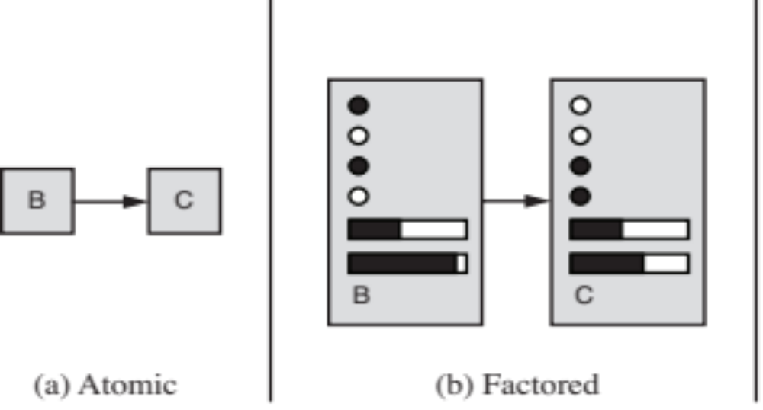
Agent Architecture: Logical Agents
A model is a structured representation of the world.
Graph-Based Search: State is black box, no internal structure, atomic.
Factored Representation: State is list or vector of facts.
Facts are expressed in formal logic.

Slide 5
Limitations of CSPs
Constraint Satisfaction Graphs can represent much information about an agent’s domain.
Inference can be a powerful addition to search (arc consistency).
Limitations of expressiveness:
  Difficult to specify complex constraints, arity > 2.
  Make explicit the form of constraints (<>, implies…).
Limitations of Inference with Arc consistency:
  Non-binary constraints.
  Inferences involving multiple variables.

Slide 6
Logic: Motivation
1st-order logic is highly expressive.
  Almost all of known mathematics.
  All information in relational databases.
  Can translate much natural language.
  Can reason about other agents, beliefs, intentions, desires…
Logic has complete inference procedures.
  All valid inferences can be proven, in principle, by a machine.
Cook’s fundamental theorem of NP-completeness states that all difficult search problems (scheduling, planning, CSP etc.) can be represented as logical inference problems. (U of T).
Notes:
Ontology is covered in detail in textbook. Mentioned by Randy. We will not cover in depth.

Slide 7
Logic vs. Programming Languages
Logic is declarative.
Think of logic as a kind of language for expressing knowledge.
  Precise, computer readable.
A proof system allows a computer to infer consequences of known facts.
Programming languages lack general mechanism for deriving facts from other facts. Traffic Rule Demo

Slide 8
Logic and Ontologies
Large collections of facts in logic are structured in hierarchices known as ontologies
  See chapter in textbook, we’re skipping it.
Cyc: Large Ontology Example.
Cyc Ontology Hierarchy.
Cyc Concepts Lookup
  E.g., games, Vancouver.

Slide 9
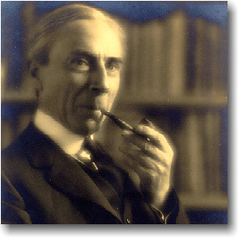
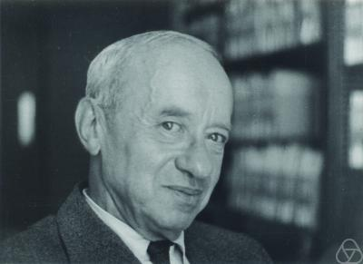
1st-order Logic: Key ideas
The fundamental question: What kinds of information do we need to represent? (Russell, Tarski).
The world/environment consists of
  Individuals/entities.
  Relationships/links among them.

Slide 10
Knowledge-Based Agents
KB = knowledge base
  A set of sentences or facts
  e.g., a set of statements in a logic language
Inference
  Deriving new sentences from old
  e.g., using a set of logical statements to infer new ones
A simple model for reasoning
  Agent is told or perceives new evidence
    E.g., A is true
  Agent then infers new facts to add to the KB
    E.g., KB = { A -> (B OR C) }, then given A and not C we can infer that B is true
    B is now added to the KB even though it was not explicitly asserted, i.e., the agent inferred B

Slide 11
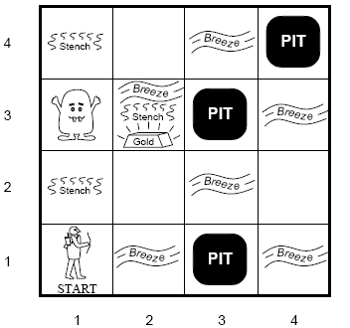
Wumpus World
Environment
  Cave of 4×4
  Agent enters in [1,1]
  16 rooms
    Wumpus: A deadly beast who kills anyone entering his room.
    Pits: Bottomless pits that will trap you forever.
    Gold

Slide 12
Wumpus World
Agents Sensors:
  Stench next to Wumpus
  Breeze next to pit
  Glitter in square with gold
  Bump when agent moves into a wall
  Scream from wumpus when killed
Agents actions
  Agent can move forward, turn left or turn right
  Shoot, one shot

Slide 13
Wumpus World
Performance measure
  +1000 for picking up gold
  -1000 got falling into pit
  -1 for each move
  -10 for using arrow

Slide 14
Reasoning in the Wumpus World
Agent has initial ignorance about the configuration
  Agent knows his/her initial location
  Agent knows the rules of the environment
Goal is to explore environment, make inferences (reasoning) to try to find the gold.
Random instantiations of this problem used to test agent reasoning and decision algorithms.

Slide 15
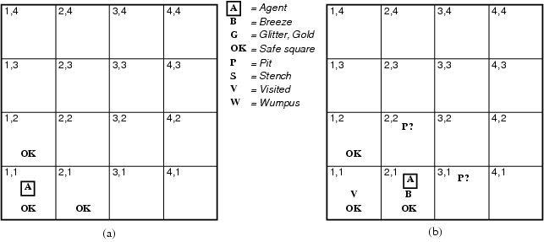
Exploring the Wumpus World
[1,1] The KB initially contains the rules of the environment.
The first percept is [none, none,none,none,none],
move to safe cell e.g. 2,1

Slide 16
Exploring the Wumpus World
[2,1] = breeze
indicates that there is a pit in [2,2] or [3,1],
return to [1,1] to try next safe cell

Slide 17
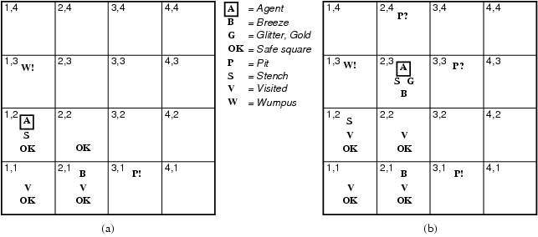
Exploring the Wumpus World
[1,2] Stench in cell which means that wumpus is in [1,3] or [2,2]
YET … not in [1,1]
YET … not in [2,2] or stench would have been detected in [2,1]
(this is relatively sophisticated reasoning!)

Slide 18
Exploring the Wumpus World
[1,2] Stench in cell which means that wumpus is in [1,3] or [2,2]
YET … not in [1,1]
YET … not in [2,2] or stench would have been detected in [2,1]
(this is relatively sophisticated reasoning!)
THUS … wumpus is in [1,3]
THUS [2,2] is safe because of lack of breeze in [1,2]
THUS pit in [1,3] (again a clever inference)
move to next safe cell [2,2]

Slide 19
Exploring the Wumpus World
[2,2] move to [2,3]
[2,3] detect glitter , smell, breeze
THUS pick up gold
THUS pit in [3,3] or [2,4]

Slide 20
What our example has shown us
Can represent general knowledge about an environment by a set of rules and facts
Can gather evidence and then infer new facts by combining evidence with the rules
The conclusions are guaranteed to be correct if
  The evidence is correct
  The rules are correct
  The inference procedure is correct
  -> logical reasoning
The inference may be quite complex
  E.g., evidence at different times, combined with different rules, etc

Slide 21
What is a logical language?
A formal language
  KB = set of sentences
Syntax
  what sentences are legal (well-formed)
  E.g., arithmetic
    X+2 >= y is a wf sentence, +x2y is not a wf sentence
Semantics
  loose meaning: the interpretation of each sentence
  More precisely:
    Defines the truth of each sentence wrt to each possible world
  e.g,
    X+2 = y is true in a world where x=7 and y =9
    X+2 = y is false in a world where x=7 and y =1
  Note: standard logic – each sentence is T of F wrt eachworld
    Fuzzy logic – allows for degrees of truth.
Notes:
Logic is like a new language, like French or mathemathical algebra.
Not as easy as CSP.
Statisticians and Economists refuse to learn.

Slide 22
Propositional logic: Syntax
Propositional logic is the simplest logic – illustrates basic ideas
Atomic sentences = single proposition symbols
  E.g., P, Q, R
  Special cases: True = always true, False = always false
Complex sentences:
  If S is a sentence, ¬S is a sentence (negation)
  If S₁ and S₂ are sentences, S₁ ∧ S₂ is a sentence (conjunction)
  If S₁ and S₂ are sentences, S₁ ∨ S₂ is a sentence (disjunction)
  If S₁ and S₂ are sentences, S₁ ⇒ S₂ is a sentence (implication)
  If S₁ and S₂ are sentences, S₁ ⇔ S₂ is a sentence (biconditional)

Slide 23

Wumpus world sentences
Let P_{i,j} be true if there is a pit in [i, j].
Let B_{i,j} be true if there is a breeze in [i, j].
  start: ¬ P_{1,1}
  ¬ B_{1,1}
  B_{2,1}
"Pits cause breezes in adjacent squares"
  B_{1,1} ⇔ (P_{1,2} ∨ P_{2,1})
  B_{2,1} ⇔ (P_{1,1} ∨ P_{2,2} ∨ P_{3,1})
KB can be expressed as the conjunction of all of these sentences
Note that these sentences are rather long-winded!
  E.g., breeze “rule” must be stated explicitly for each square
  First-order logic will allow us to define more general patterns.

Slide 24
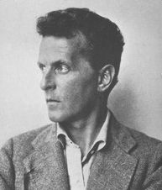
Propositional logic: Semantics
A sentence is interpreted in terms of models, or possible worlds.
These are formal structures that specify a truth value for each sentence in a consistent manner.
Ludwig Wittgenstein (1918):
The world is everything that is the case.
1.1 The world is the complete collection of facts, not of things.
1.11 The world is determined by the facts, and by being the complete collection of facts.

Slide 25
More on Possible Worlds
m is a model of a sentence α if α is true in m
M(α) is the set of all models of α
Possible worlds ~ models
  Possible worlds: potentially real environments
  Models: mathematical abstractions that establish the truth or falsity of every sentence
Example:
  x + y = 4, where x = #men, y = #women
  Possible models = all possible assignments of integers to x and y.
  For CSPs, possible model = complete assignment of values to variables.
  Wumpus Example Assignment style

Slide 26
Propositional logic: Formal Semantics
Each model/world specifies true or false for each proposition symbol
  E.g. P_{1,2} P_{2,2} P_{3,1}
  false true false
  With these symbols, 8 possible models, can be enumerated automatically.
Rules for evaluating truth with respect to a model m:
¬S is true iff S is false
S₁ ∧ S₂ is true iff S₁ is true and S₂ is true
S₁ ∨ S₂ is true iff S₁is true or S₂ is true
S₁ ⇒ S₂ is true iff S₁ is false or S₂ is true
i.e., is false iff S₁ is true and S₂ is false
S₁ ⇔ S₂ is true iff S₁⇒S₂ is true andS₂⇒S₁ is true
Simple recursive process evaluates every sentence, e.g.,
¬P_{1,2} ∧ (P_{2,2} ∨ P_{3,1}) = true ∧ (true ∨ false) = true ∧ true = true

Slide 27

Truth tables for connectives

Slide 28
Truth tables for connectives
Evaluation Demo - Tarki's World
Implication is always true
when the premise is false
Why? P=>Q means “if P is true then I am claiming that Q is true,
otherwise no claim”
Only way for this to be false is if P is true and Q is false

Slide 29


Wumpus models
KB = all possible wumpus-worlds consistent with the observations and the “physics” of the Wumpus world.

Slide 30

Listing of possible worlds for the Wumpus KB
  α₁ = ”square [1,2] is safe”.
  KB = detect nothing in [1,1], detect breeze in [2,1]

Slide 31
Entailment
One sentence follows logically from another
α |= β
α entails sentence β if and only if β is true in all worlds where α is true.
e.g., x+y=4 |= 4=x+y
Entailment is a relationship between sentences that is based on semantics.

Slide 32
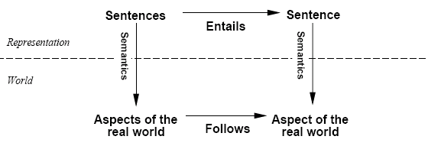
Schematic perspective
If KB is true in the real world, then any sentence α derived
from KB by a sound inference procedure is also true in the
real world.
Notes:
See also Assignment 3.

Slide 33

Entailment in the wumpus world
Consider possible models for KB assuming only pits and a reduced Wumpus world
Situation after detecting nothing in [1,1], moving right, detecting breeze in [2,1]

Slide 34

Wumpus models
All possible models in this reduced Wumpus world.

Slide 35
Inferring conclusions
Consider 2 possible conclusions given a KB
  α₁ = "[1,2] is safe"
  α₂ = "[2,2] is safe“
One possible inference procedure
  Start with KB
  Model-checking
    Check if KB ╞ α by checking if in all possible models where KB is true that α is also true
Comments:
  Model-checking enumerates all possible worlds
    Only works on finite domains, will suffer from exponential growth of possible models

Slide 36

Wumpus models
α₁ = "[1,2] is safe", KB ╞ α₁, proved by model checking

Slide 37

Wumpus models
α₂ = "[2,2] is safe", KB ╞ α₂
  There are some models entailed by KB where α₂ is false.
  Wumpus Example Assignment style

Slide 38
Logical inference
The notion of entailment can be used for inference.
  Model checking (see wumpus example): enumerate all possible models and check whether α is true.
If an algorithm only derives entailed sentences it is called sound or truth preserving.
A proof system is sound if whenever the system derives α from KB, it is also true that KB|= α
  E.g., model-checking is sound
Completeness : the algorithm can derive any sentence that is entailed.
A proof system is complete if whenever KB|= α, the system derives α from KB.

Slide 39
Inference by enumeration
We want to see if α is entailed by KB
Enumeration of all models is sound and complete.
But…for n symbols, time complexity is O(2^{n})...
We need a more efficient way to do inference
  But worst-case complexity will remain exponential for propositional logic

Slide 40

Logical equivalence
To manipulate logical sentences we need some rewrite rules.
Two sentences are logically equivalent iff they are true in same models: α ≡ ß iff α╞ β and β╞ α
Notes:
Another example: solve equation in 1 unknown.
Demonstrate in tarksi demo.

Slide 41
Exercises
Show that P implies Q
is logically equivalent to (not P) or Q.
That is, one of these formulas is true in a model just in case the other is true.
A literal is a formula of the form P or of the form not P, where P is an atomic formula. Show that the formula (P or Q) and (not R) has an equivalent formula that is a disjunction of a conjunction of literals. Thus the equivalent formula looks like this:
[literal 1 and literal 2 and ….] or [literal 3 and …]

Slide 42

Propositional Logic vs. CSPs
CSPs are a special case as follows.
The atomic formulas are of the type
Variable = value.
E.g., (WA = green).
Negative constraints correspond to negated conjunctions.
E.g. not (WA = green and NT = green).
Exercise: Show that every (binary) CSP is equivalent to a conjunction of literal disjunctions of the form
[variable 1 = value 1 or variable 1 = value 2 or variable 2 = value 2 or ….] and […]
Notes:
Solution: use de Morgan to convert negated conjunction to disjunctions.

Slide 43



Modus Ponens
And-Elimination
Bi-conditional Elimination

Slide 44
Normal Clausal Form
Eventually we want to prove:
Knowledge base KB entails sentence α
We first rewrite into conjunctive normal form (CNF).
literals
A “conjunction of disjunctions”
(A ∨ ¬B) ∧ (B ∨ ¬C ∨ ¬D)
Clause
Clause
Theorem: Any KB can be converted into an equivalent CNF.
k-CNF: exactly k literals per clause
Notes:
Can you prove this?

Slide 45
Example: Conversion to CNF
B_{1,1} ⇔ (P_{1,2} ∨ P_{2,1})
Eliminate ⇔, replacing α ⇔ β with (α ⇒ β)∧(β ⇒ α).
  (B_{1,1} ⇒ (P_{1,2} ∨ P_{2,1})) ∧ ((P_{1,2} ∨ P_{2,1}) ⇒ B_{1,1})
2. Eliminate ⇒, replacing α ⇒ β with ¬α∨ β.
  (¬B_{1,1} ∨ P_{1,2} ∨ P_{2,1}) ∧ (¬(P_{1,2} ∨ P_{2,1}) ∨ B_{1,1})
3. Move ¬ inwards using de Morgan's rules and double-negation:
  (¬B_{1,1} ∨ P_{1,2} ∨ P_{2,1}) ∧ ((¬P_{1,2} ∧ ¬P_{2,1}) ∨ B_{1,1})
4. Apply distributive law (∧ over ∨) and flatten:
  (¬B_{1,1} ∨ P_{1,2} ∨ P_{2,1}) ∧ (¬P_{1,2} ∨ B_{1,1}) ∧ (¬P_{2,1} ∨ B_{1,1})

Slide 46



Horn Clauses
Horn Clause = A clause with at most 1 positive literal.
e.g.
Every Horn clause can be rewritten as an implication with
a conjunction of positive literals in the premises and at most a single
positive literal as a conclusion.
e.g.
1 positive literal: definite clause
0 positive literals: Fact or integrity constraint:
e.g.
Psychologically natural: a condition implies (causes) a single fact.
The basis of logic programming (the prolog language).
SWI Prolog. Prolog and the Semantic Web. Prolog Applications
Notes:
Show Aispace demo.
In application, easy to specify rules, interchange format.
See especially “Air” application, .e.g. Boeing.

Slide 47
Summary
Logical agents apply inference to a knowledge base to derive new information and make decisions
Basic concepts of logic:
  syntax: formal structure of sentences
  semantics: truth of sentences wrt models
  entailment: necessary truth of one sentence given another
  inference: deriving sentences from other sentences
  soundness: derivations produce only entailed sentences
  completeness: derivations can produce all entailed sentences.
The Logic Machine in Isaac Asimov’s Foundation Series.

